Slide 1
Architectural Acoustics
Week 5: Building Acoustics
Lecture B.2
Jieun Yang (j.yang3@tue.nl) Assistant professor, Building Acoustics group

Slide 2
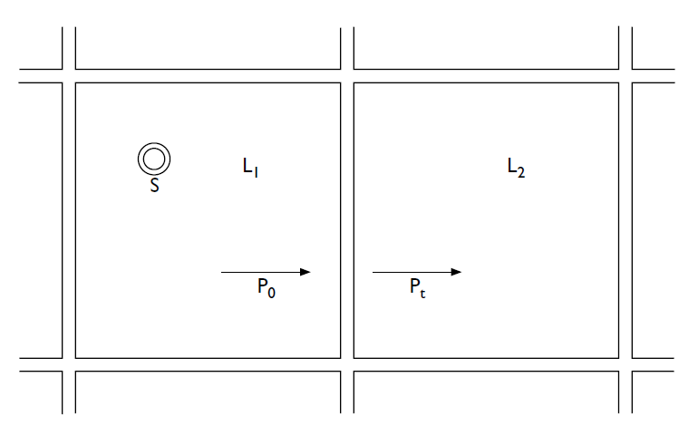
Introduction: Building Acoustics
Lecture B.1 (Chapter 10)
Lecture B.2 (Chapter 14)
Lecture B.3 (Vigran Chapter 9)
Sound waves in isotropic solids
Building Acoustics
Sound reduction through multiple surfaces and ducts
Flanking sound transmission

Slide 3
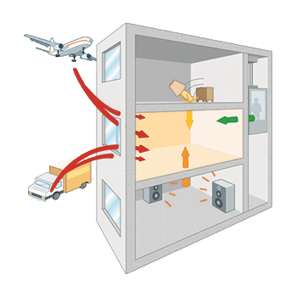



Chapter 14. Building Acoustics
Air-borne sound vs. Structure-borne sound
Air-borne
Floor/Ceiling
Source room
Wall
Receiving room
Source room
Structure-borne
Structure-borne
Structure-borne
Air-borne
Receiving room
Air → solid (wall) → air
Solid (floor) → air
Air-borne
Air-borne

Slide 4
Chapter 14. Building Acoustics
Air-borne sound insulation
Characterization & Measurements
Single leaf partition
Double leaf partition
Incident sound
Transmitted sound
Incident sound
Transmitted sound

Slide 5
14.1 Characterization and measurement
Sound reduction index
Sound reduction index
(or sound transmission loss, transmission loss)
S
[dB]
Source
Source room
Receiver room
For measurements we prefer to use
[dB]
→ will be continued in slide 6
(S = surface area of the partition)

Slide 6
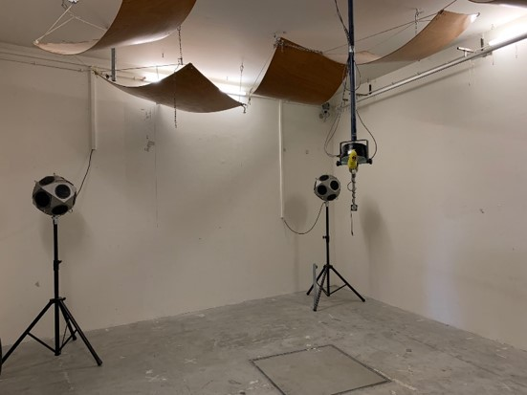
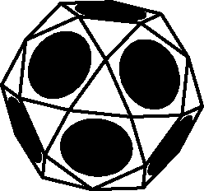
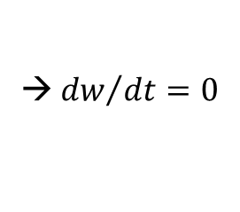
14.1 Characterization and measurement
Measurements
Requires diffuse sound field
Direction and phase of sound waves can be regarded as random
Acoustic energy density w [J/m³] is a constant
→ ${dw}/{dt}=0$
Source room
Receiver room
Sound source
Acoustic diffusers
Microphone
Microphone
Concrete walls
Two reverberation rooms
Reverberation room in acoustic lab (Echo)

Slide 7
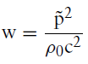
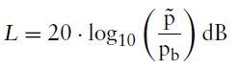
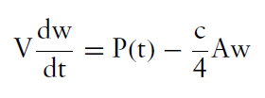
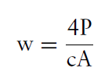
14.1 Characterization and measurement
Measurements
Incident power (source room):
Sound reduction index
Substitute into
S: the surface area of the partition
→
Transmitted power in receiver room:
A: Equivalent absorption area of the receiving room
(Obtained from the measured reverberation time)
,
Chapter 13.4
This leads to
Temporal change of energy content
= power radiated by wall - power absorbed by boundaries
→
Sound reduction index of a partition measured by two reverberation room method

Slide 8
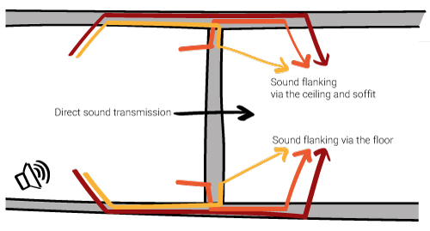
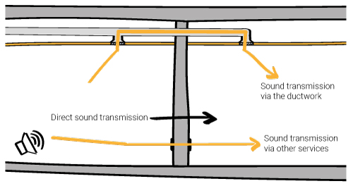
14.1 Characterization and measurement
Field measurements
Direct transmission + Flanking transmission
https://ateliercrescendo.ac/laboratory-or-on-site-sound-insulation-rating/

Slide 9
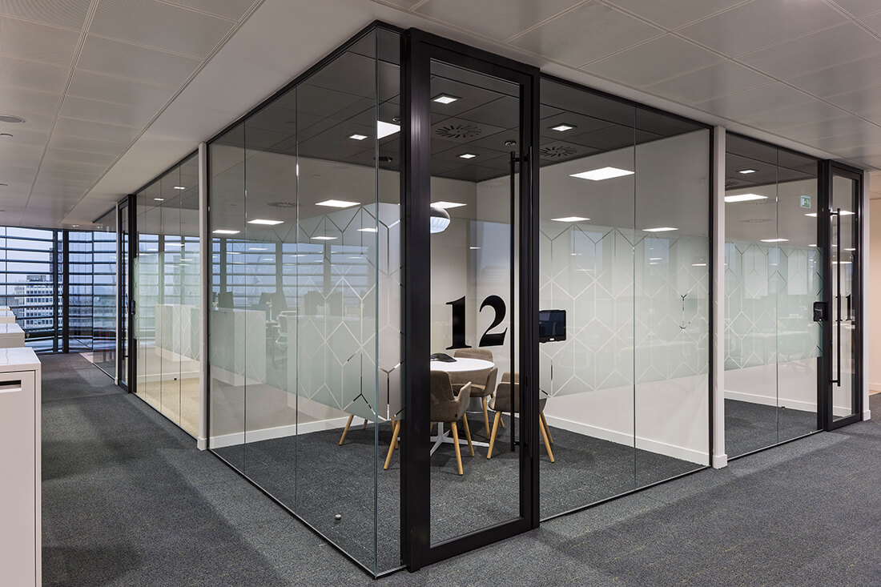

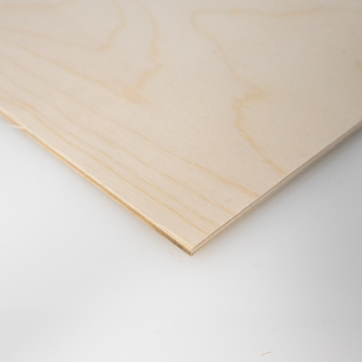
14.3 Single leaf partitions
Single leaf partition
(very thin plate)
Incident sound
Transmitted sound

Slide 10
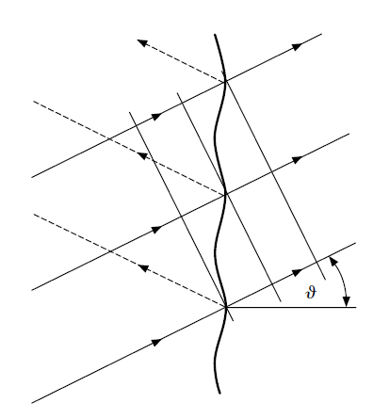


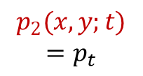
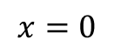
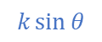
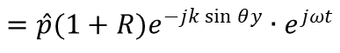
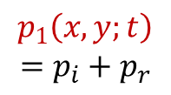
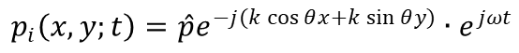

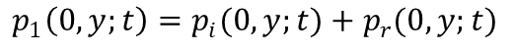
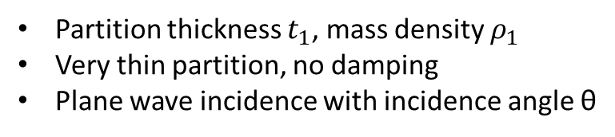

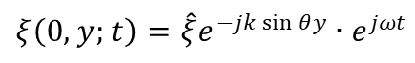

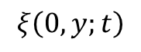
14.3 Single leaf partitions
Sound waves around a single leaf partition
y
Partition thickness $t_{1}$, mass density $ρ_{1}$
Very thin partition, no damping
Plane wave incidence with incidence angle θ
x
Transmitted
wave $p_{t}$
Incident, reflected, and transmitted pressures
$$p_{i}\left(x,y;t\right)=\hat{p}e^{−j(k\cos{θ}x+k\sin{θ}y)}∙e^{jωt}$$
$$p_{r}\left(x,y;t\right)=\hat{p}Re^{−j(−k\cos{θ}x+k\sin{θ}y)}∙e^{jωt}$$
Reflected wave$p_{r}$
$$p_{t}\left(x,y;t\right)=\hat{p}Te^{−j(k\cos{θ}x+k\sin{θ}y)}∙e^{jωt}$$
$$k\sin{θ}$$
Pressures on both sides of the partition (at $x=0$)
$$k$$
Incident wave $p_{i}$
$$p_{1}\left(0,y;t\right)=p_{i}(0,y;t)+p_{r}(0,y;t)$$
$$k\cos{θ}$$
$$=\hat{p}(1+R)e^{−jk\sin{θ}y}∙e^{jωt}$$
$$p_{1}\left(x,y;t\right)$$
$$=p_{i}+p_{r}$$
$$p_{2}(x,y;t)$$
$${=p}_{t}$$
$$p_{2}\left(0,y;t\right)=p_{t}\left(0,y;t\right)=\hat{p}Te^{−jk\sin{θ}y}∙e^{jωt}$$
$$x=0$$
$$ξ\left(0,y;t\right)$$
Displacement component of the partition (at $x=0$)
$$ξ\left(0,y;t\right)=\hat{ξ}e^{−jk\sin{θ}y}∙e^{jωt}$$

Slide 11
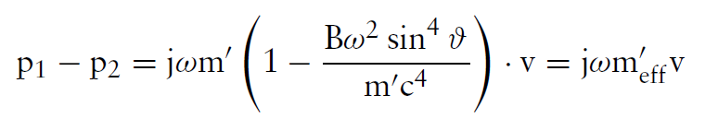
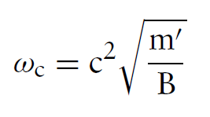
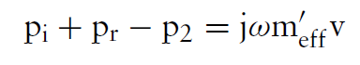
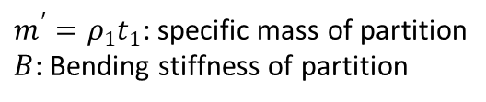
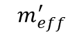

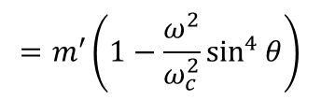
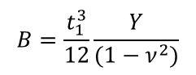
14.3 Single leaf partitions
Sound waves around a single leaf partition
y
Bending wave equation,
imposed force is pressure difference over wall (at $x=0$)
x
Transmitted
wave $p_{t}$
$m^{′}=ρ_{1}t_{1}$: specific mass of partition
$B$: Bending stiffness of partition
$$B=\frac{t_{1}^{3}}{12}\frac{Y}{(1−ν^{2})}$$
→
Reflected wave$p_{r}$
Expressing the displacement $ξ$ of the wall by its velocity $v = jωξ$
Incident wave $p_{i}$
$$=m′\left(1−\frac{ω^{2}}{ω_{c}^{2}}\sin^{4}{θ}\right)$$
in lecture B.1
$$p_{1}\left(x,y;t\right)$$
$$=p_{i}+p_{r}$$
$$p_{2}(x,y;t)$$
$${=p}_{t}$$
$$m_{eff}^{′}$$
$$x=0$$
$$ξ\left(0,y;t\right)$$
(1)

Slide 12
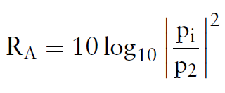
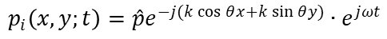
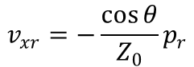
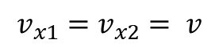
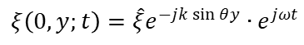
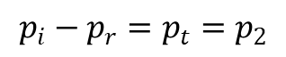
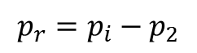
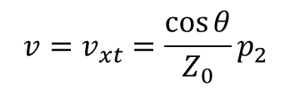
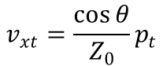
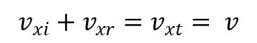
14.3 Single leaf partitions
$$p_{i}\left(x,y;t\right)=\hat{p}e^{−j(k\cos{θ}x+k\sin{θ}y)}∙e^{jωt}$$
$$p_{r}\left(x,y;t\right)=\hat{p}Re^{−j(−k\cos{θ}x+k\sin{θ}y)}∙e^{jωt}$$
$$p_{t}\left(x,y;t\right)=\hat{p}Te^{−j(k\cos{θ}x+k\sin{θ}y)}∙e^{jωt}$$
Sound waves around a single leaf partition
$$ξ\left(0,y;t\right)=\hat{ξ}e^{−jk\sin{θ}y}∙e^{jωt}$$
y
Normal velocity continuity (at $x=0$)
x
Transmitted
wave $p_{t}$
$$v_{x1}=v_{x2}= v$$
→
$$v_{xi}+v_{xr}=v_{xt}= v$$
(2)
$$v_{xi}(x,y;t)=−\frac{1}{jωρ_{0}}\frac{∂p_{i}}{∂x}=\frac{k\cos{θ}}{ωρ_{0}}\hat{p}e^{−j\left(k\cos{θ}x+k\sin{θ}y\right)}∙e^{jωt}=\frac{\cos{θ}}{Z_{0}}p_{i}$$
Similarly,
$$v_{xr}=−\frac{\cos{θ}}{Z_{0}}p_{r}$$
,
$$v_{xt}=\frac{\cos{θ}}{Z_{0}}p_{t}$$
Reflected wave$p_{r}$
$$p_{i}−p_{r}=p_{t}=p_{2}$$
$$v=v_{xt}=\frac{\cos{θ}}{Z_{0}}p_{2}$$
(2’)
$$p_{r}=p_{i}−p_{2}$$
(3)
Incident wave $p_{i}$
To calculate sound reduction index,
$$p_{1}\left(x,y;t\right)$$
$$=p_{i}+p_{r}$$
$$p_{2}(x,y;t)$$
$${=p}_{t}$$
$$x=0$$
$$ξ\left(0,y;t\right)$$

Slide 13
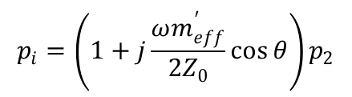
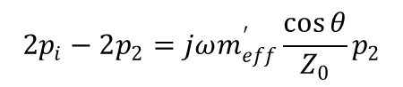
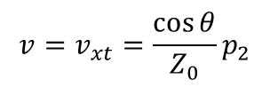
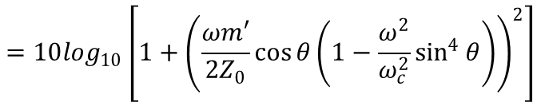
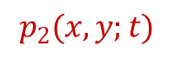
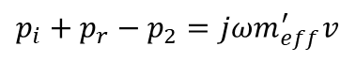
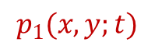
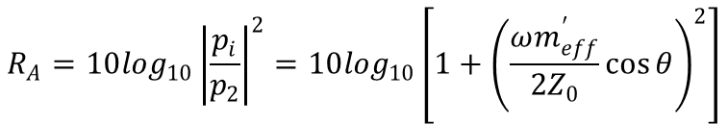
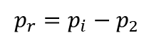
14.3 Single leaf partitions
Sound reduction index of single leaf partitions
Equations (1), (2’), and (3)
Transmitted
wave $p_{t}$
(1):
$$p_{i}+p_{r}−p_{2}=jωm_{eff}^{′}v$$
(2’):
$$v=v_{xt}=\frac{\cos{θ}}{Z_{0}}p_{2}$$
(3):
$$p_{r}=p_{i}−p_{2}$$
Substitute (2’) and (3) to (1)
$$2p_{i}−2p_{2}=jωm_{eff}^{′}\frac{\cos{θ}}{Z_{0}}p_{2}$$
$$p_{i}=\left(1+j\frac{ωm_{eff}^{′}}{{2Z}_{0}}\cos{θ}\right)p_{2}$$
Reflected wave$p_{r}$
→
Sound reduction index
Incident wave $p_{i}$
$$R_{A}=10\log_{10}{\left|\frac{p_{i}}{p_{2}}\right|}^{2}=10\log_{10}\left[1+{\left(\frac{ωm_{eff}^{′}}{{2Z}_{0}}\cos{θ}\right)}^{2}\right]$$
$$p_{1}(x,y;t)$$
$$p_{2}(x,y;t)$$
$$x=0$$
$$=10\log_{10}\left[1+{\left(\frac{ωm′}{{2Z}_{0}}\cos{θ}\left(1−\frac{ω^{2}}{ω_{c}^{2}}\sin^{4}{θ}\right)\right)}^{2}\right]$$
$$ξ\left(0,y;t\right)$$

Slide 14




14.3 Single leaf partitions
Sound reduction index characteristic
(i) For $ω/{ω_{c}}≪1$ or normal incidence ($θ=0$)
$$R_{A}=10\log_{10}\left[1+{\left(\frac{ωm′}{{2Z}_{0}}\cos{θ}\left(1−\frac{ω^{2}}{ω_{c}^{2}}\sin^{4}{θ}\right)\right)}^{2}\right]$$
$$R_{A}≈10\log_{10}\left[{\left(\frac{ωm^{′}}{{2Z}_{0}}\cos{θ}\right)}^{2}\right]=20\log_{10}\left|\frac{ωm^{′}}{{2Z}_{0}}\cos{θ}\right|$$
Approximately 6 dB increase for doubling frequency (+ 6 dB/octave)
Normal incidence
Approximately 6 dB increase for doubling mass → Mass law
Mass controlled region
+ 6 dB/octave
$θ$ increasing

Slide 15






14.3 Single leaf partitions
Sound reduction index characteristic
(ii) For $ω/{ω_{c}}=1/{\sin^{2}{θ}}$,
$$R_{A}=10\log_{10}\left[1+{\left(\frac{ωm′}{{2Z}_{0}}\cos{θ}\left(1−\frac{ω^{2}}{ω_{c}^{2}}\sin^{4}{θ}\right)\right)}^{2}\right]$$
$$R_{A}=10\log_{10}1=0$$
= 0
Total transmission (no sound insulation)!
Coincidence frequency
$$ω_{co}={ω_{c}}/{\sin^{2}{θ}}$$
Critical frequency $=c^{2}\sqrt{{m′}/B}$
Normal incidence
“projection” of the wavenumber (or the wavelength) in air corresponds to the bending wavenumber of the wall
: coincidence condition
Pressure maxima and minima are spatially matched → energy is easily transmitted from the air into the partition and vice versa
Dependent on the incidence angle (c.f., $ω_{c}=c^{2}\sqrt{{m′}/B}$)
Critical frequency ($ω_{c}$) is lowest coincidence frequency
Coincidence frequencies

Slide 16


14.3 Single leaf partitions
Sound reduction index characteristic
(iii) For $ω/{ω_{c}}≫1$
$$R_{A}=10\log_{10}\left[1+{\left(\frac{ωm′}{{2Z}_{0}}\cos{θ}\left(1−\frac{ω^{2}}{ω_{c}^{2}}\sin^{4}{θ}\right)\right)}^{2}\right]$$
$$R_{A}≈10\log_{10}\left[{\left(−\frac{ωm^{′}}{{2Z}_{0}}\frac{ω^{2}}{ω_{c}^{2}}\sin^{4}{θ}\cos{θ}\right)}^{2}\right]$$
$$=20\log_{10}\left|\frac{Bω^{3}}{{2Z}_{0}c^{2}}\sin^{4}{θ}\cos{θ}\right|$$
+ 18 dB/octave
Normal incidence
Approximately 18 dB increase for doubling frequency (+ 18 dB/octave)
Stiffness-controlled region

Slide 17








14.3 Single leaf partitions
Sound reduction index characteristic
More on coincidence frequency
Below $ω_{co}$
At $ω_{co}$
Above $ω_{co}$
: coincidence condition
Bending waves
Speed of bending waves $c_{B}$
Wave speed
$$c/{\sin{θ}}$$
x
x
Speed of sound c
Critical frequency
Coincidence frequency
Sound waves
$$ω_{c}$$
$$ω_{co}$$
Frequency
https://apmr.matelys.com/BasicsAcoustics/CoincidenceFrequency/index.html

Slide 18



14.3 Single leaf partitions
Sound reduction index of single leaf partitions – Real situations
We also should include
Random incident sound waves
Damping of bending waves
Finite dimensions of partitions
https://apmr.matelys.com/BasicsAcoustics/TL/index.html
+6 dB/octave
~3dB
Dip around $ω_{c}$
General form of the diffuse field TL curve
Fahy, Sound and Structural Vibration 2nd Ed., 2007
Long, Architectural Acoustics 2nd Ed., 2014

Slide 19



14.4 Double leaf partitions
Double leaf partition
Incident sound
Transmitted sound
https://images.app.goo.gl/y1mcDM6JeJrU75pc9
Single glazed
Double glazed
Triple glazed

Slide 20

















14.4 Double leaf partitions
Sound reduction index of double leaf partitions
For normally incident plane waves
$$ρ_{1}$$
$$ρ_{2}$$
$$t_{1}$$
$$t_{2}$$
air
$${m′}_{1}$$
$${m′}_{2}$$
where $n^{′}=\frac{d}{cZ_{0}}$
($Z_{0}=ρ_{0}c$: characteristic impedance of air)
$$m_{1}^{′}=ρ_{1}t_{1}$$
Specific mass of partition 1
$$m_{2}^{′}=ρ_{2}t_{2}$$
Specific mass of partition 2

Slide 21







14.4 Double leaf partitions
Sound reduction index characteristic
12 dB/octave
Single partition at low frequencies
$$R_{A}≈20\log_{10}\left|\frac{ωm^{′}}{{2Z}_{0}}\cos{θ}\right|$$
air
(i) At very low frequencies,
$${m′}_{1}$$
$${m′}_{2}$$
$$R_{A}=20\log_{10}\left|\frac{ω(m_{1}^{′}+m_{2}^{′})}{{2Z}_{0}}\right|$$
mass-air-mass
resonance
→
6 dB increase per octave
Follows mass law ($m_{1}^{′}+m_{2}^{′}=$ total mass of the system)
(ii) At $ω=\sqrt{\frac{1}{n′}\left(\frac{1}{m_{1}^{′}}+\frac{1}{m_{2}^{′}}\right)}$
: mass-air-mass resonance
imaginary part of ${p_{i}}/{p_{2}=0}$
→ Resonance of the system, Both layers vibrate in equal phases

Slide 22




14.4 Double leaf partitions
Sound reduction index characteristic
12 dB/octave
(iii) Beyond resonance frequency,
$$R_{A}≈20\log_{10}\left(\frac{ω^{3}n′m_{1}^{′}m_{2}^{′}}{2Z_{0}}\right)$$
18 dB increase per octave
First cavity resonance
(iv) At very high frequencies,
The thickness of the air gap between the layers becomes comparable to the acoustical wavelength → cannot be regarded as lumped elements anymore
$R_{A}$ ~ 12 dB increase per octave
Sharp dips on the curves at
Cavity resonances

Slide 23





14.4 Double leaf partitions
Single leaf partition
Double leaf partition
+ 18 dB/octave
12 dB/octave
Stiffness-controlled
air
Normal incidence
$${m′}_{1}$$
$${m′}_{2}$$
mass-air-mass
resonance
+ 6 dB/octave
Mass-controlled
First cavity resonance
$θ$ increasing
Coincidence frequencies

Slide 24



14.4 Double leaf partitions
Sound reduction index of double leaf partitions – Real situations
We also should include
Damping of bending waves
Finite dimensions of partitions (mechanical coupling of layers)
Random incident sound waves
Top view
12 mm chipboards with a cavity of depth 95 mm filled with mineral wool
Installation method to prevent mechanical coupling
(Vigran, Building Acoustics)

Slide 25


Summary
Lecture B.2 (Chapter 14)
Building Acoustics – Airborne sound insulation
Sound reduction index
Sound reduction index by measurement
Single leaf partition & Double leaf partition
+ 18 dB/octave
12 dB/octave
Stiffness-controlled
Normal incidence
air
$${m′}_{1}$$
$${m′}_{2}$$
+ 6 dB/octave
Mass-controlled
mass-air-mass
resonance
First cavity resonance
$θ$ increasing
Coincidence frequencies

Slide 26
& for all f under normal incidence

